Slide 1


Brazil Climate Analysis
Joao Costa, Michelle Fitzpatrick, Stacy Giauque & Hannah Moy
Notes:
Stacy

Slide 2

What do we want to know?
How has precipitation, fire, and deforestation changed throughout the years?
What are limitations with our data?
What are the correlations between precipitation, fire, and deforestation? ...Are there any?
Notes:
Stacy

Slide 3
What do we want to know?
How has precipitation, fire, and deforestation changed throughout the years in Brazil?
What is the precipitation in Brazil?
How many forest fires Brazil has on the past year?
Is the deforestation increasing?
Notes:
Stacy
Decompose the “Ask”...

Slide 4
What do we want to know?
What are limitations with our data?
Data Limitations
Do we have the information for all states?
Will we look through all the different biomes in Brazil?
Do we have a consistent serie of data?
Data Sources
TerraBrasilis - Deforestation data
Kaggle - Precipitation
Kaggle - Forest Fires
Notes:
Stacy

Slide 5
What do we want to know?
What are the correlations between precipitation, fire, and deforestation? Are there any?
Analysis of the Precipitation
Analysis of the Number of Fires
Analysis of the Deforestation
Look through the data and see if there’s any correlation between them
Notes:
Stacy

Slide 6
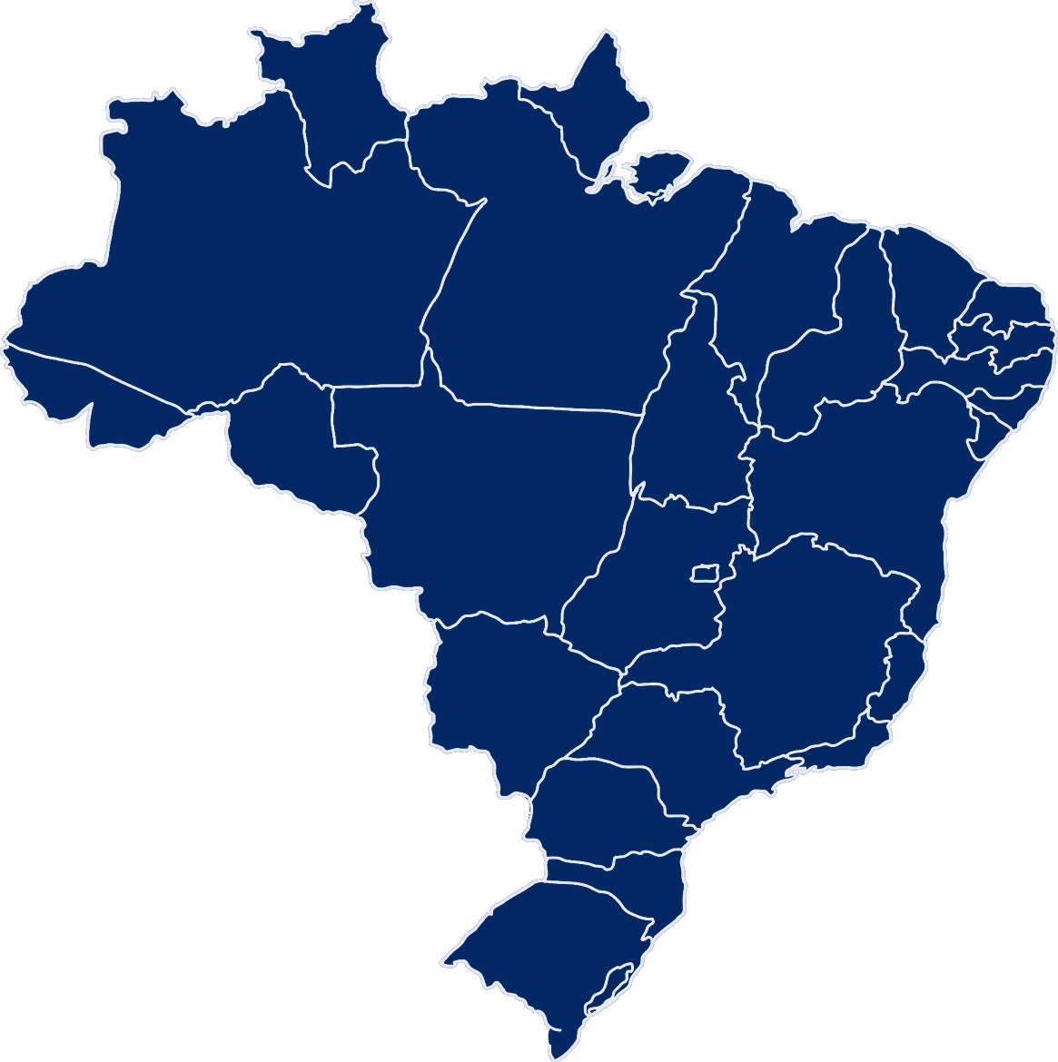
Notes:
Stacy
Brazil map
27 Federal States
Capital - Brasilia (Federal Capital)
Largest City - Sao Paulo, Sao Paulo
5th Largest country by geography 3.3m sq miles or just slightly smaller than the United States
5th largest country by population 210million
Let’s look at the data...

Slide 7
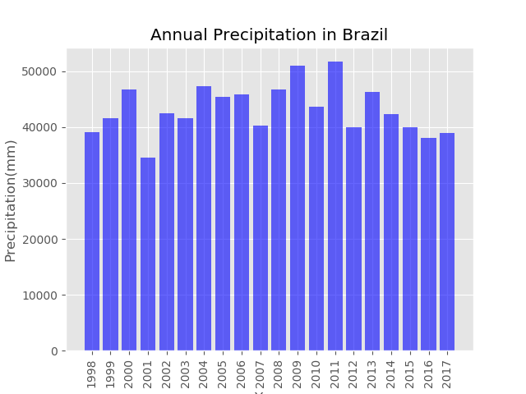
Notes:
Hannah
Sum - 50,000 mm = 1,968 inches
Reference NYC in 2018 got 65.55

Slide 8
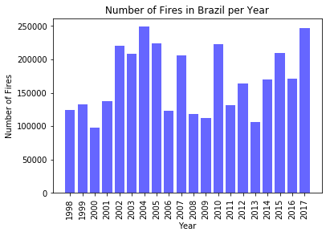
Brazil Annual Number of Fires
Notes:
Michelle

Slide 9
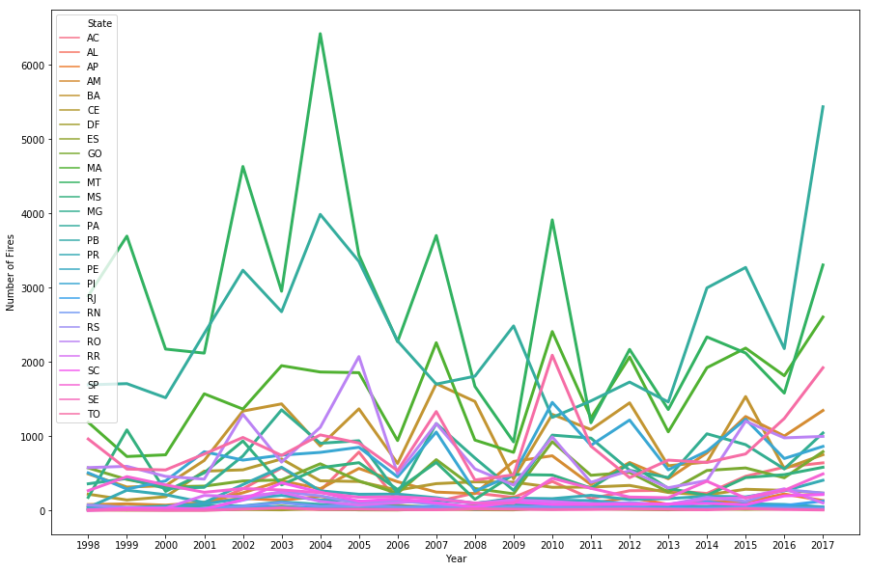
Brazil Annual Number of Fires
Notes:
Michelle

Slide 10
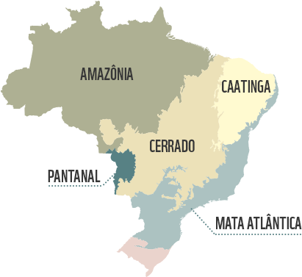
Notes:
Joao
Brazil Biomes
Amazonia - Rain Forest
Pantanal - Wetlands, flooded area on the rain season
Cerrado - Tropical Savanna, two seasons (wet and dry), very fire-adapted
Mata Atlantica - Very unique biome composed of various types of vegetation and climate (broad-leaf tropical forests, tropical and subtropical grasslands, savannas, and shrublands, and mangrove forests)
Caatinga - Caatinga is an indigenous word meaning "white forest". It is a desert vegetation, with Cacti, thorny brush
Pampas - are fertile South American lowlands where the dominant vegetation types are grassy prairie and grass steppe

Slide 11
Legal Amazon
Legal Amazon is a socio-geographic division in Brazil, containing nine states with the Amazon Biome. It represents circa 60% of Brazil area, but only around 12% of Brazilian population lives in this area.
The region is home to the entire Amazon biome, the largest of the Brazilian biomes, which accounts for 1/3 of the planet's tropical rainforests. It has the highest biodiversity, the largest genetic bank and 1/5 of the world's availability of drinking water.
Notes:
Stacy
It was created in 1953 to promote the development of agricultural production and the integration of the Region into the national economy, as this part of the country was very isolated and underdeveloped.
Made up of 9 Federal States (one was excluded in rainfall due to lack of data)

Slide 12
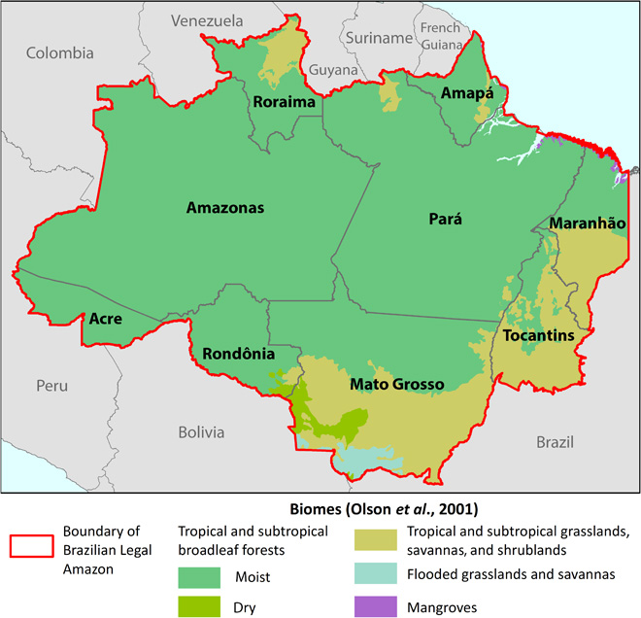
Notes:
Stacy
Why we choose Legal Amazon?
Data limitations - Our data is divided by state, not by biome
Geographically - It's a discreet way to look through the data, since biomes do not respect state borders.
Biome relevance - (last slide…)

Slide 13
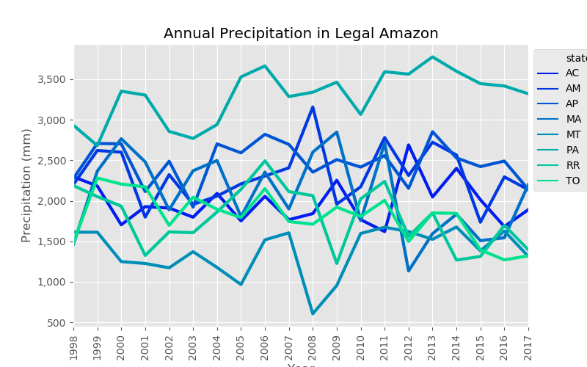
Notes:
Hannah
Annual precipitation of the sum across the legal amazon states
Para - highest precip - in rainy areas; Mato Grosso - lowest precip - in a few diff biomes so it includes legal amazon + other biomes

Slide 14
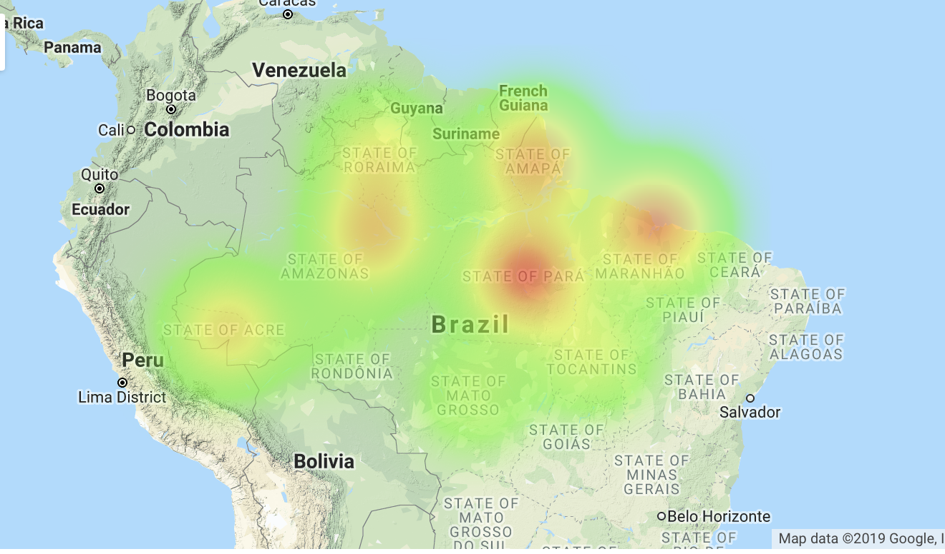
Heat Map: Legal Amazon Precipitation
Notes:
Stacy
2017 Point in Time
Interior state of Para has a very precipitous/rainy climate - subequatorial
Followed by Maranhao

Slide 15
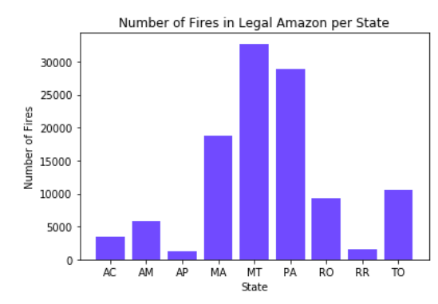
Legal Amazon: Fire Analysis
Notes:
Michelle

Slide 16
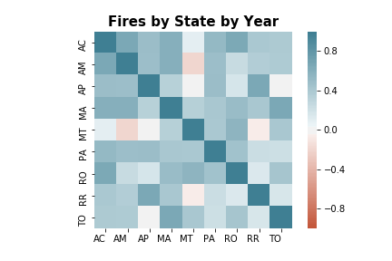
Legal Amazon: Fire Analysis
Notes:
Michelle

Slide 17
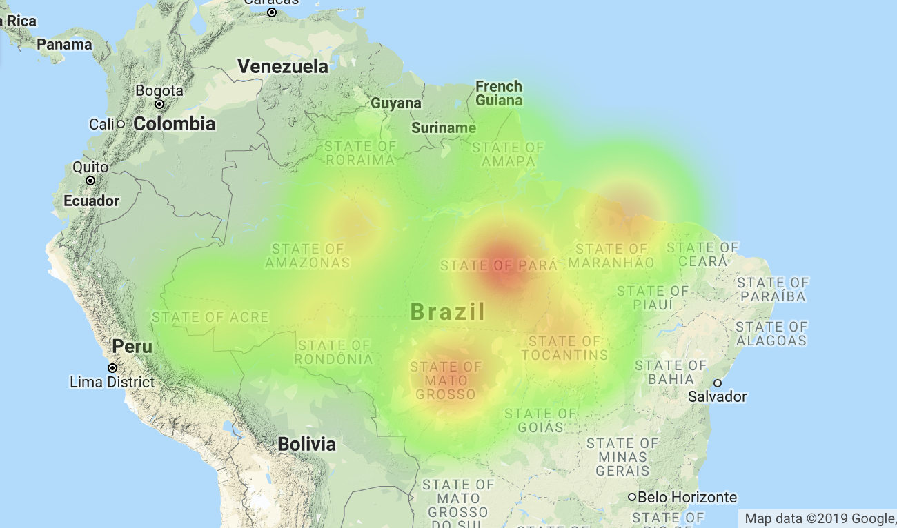
Heat Map: Legal Amazon Fire
Notes:
Michelle

Slide 18
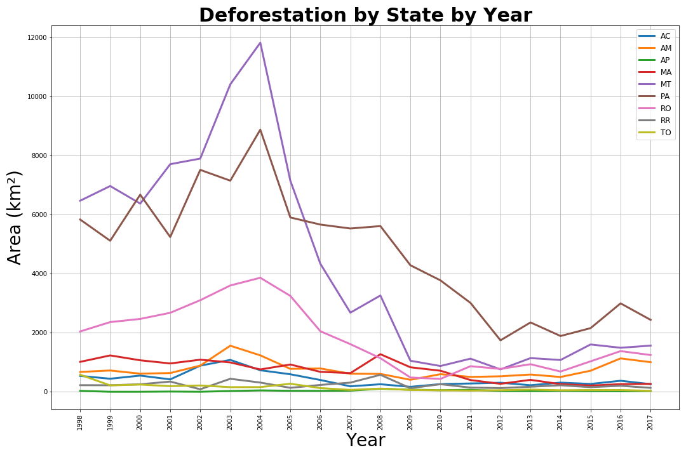
Notes:
Joao
Pará's economy is based on mineral (iron, bauxite, manganese, limestone, gold, tin) and vegetal (wood) extraction, agriculture, livestock, industry and tourism.
76.6% of Pará exports are non-renewable natural resources.
Mato Grosso has an economy based on agriculture, mainly soy production and cattle raising.

Slide 19
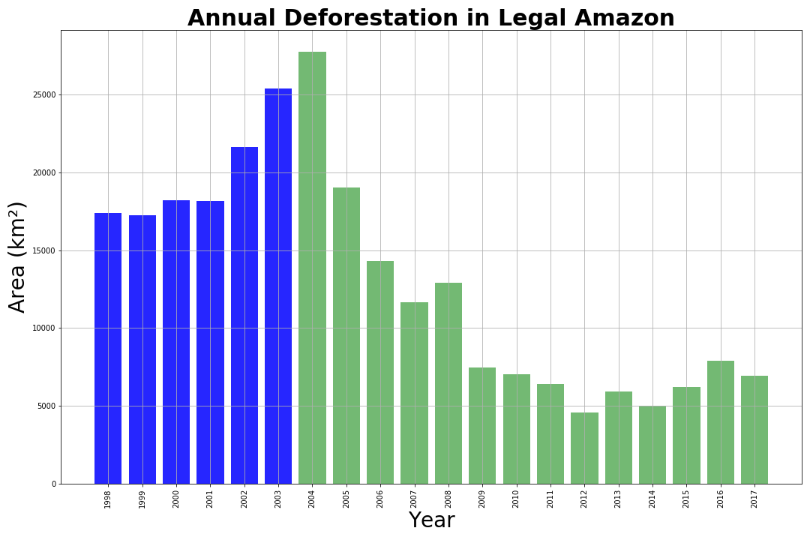
Notes:
JOAO
PPCDAm
The Action Plan for the Prevention and Control of Deforestation in the Legal Amazon , launched in 2004, aims to reduce deforestation rates continuously and to bring about the conditions for a transition towards a sustainable development model in the region.

Slide 20
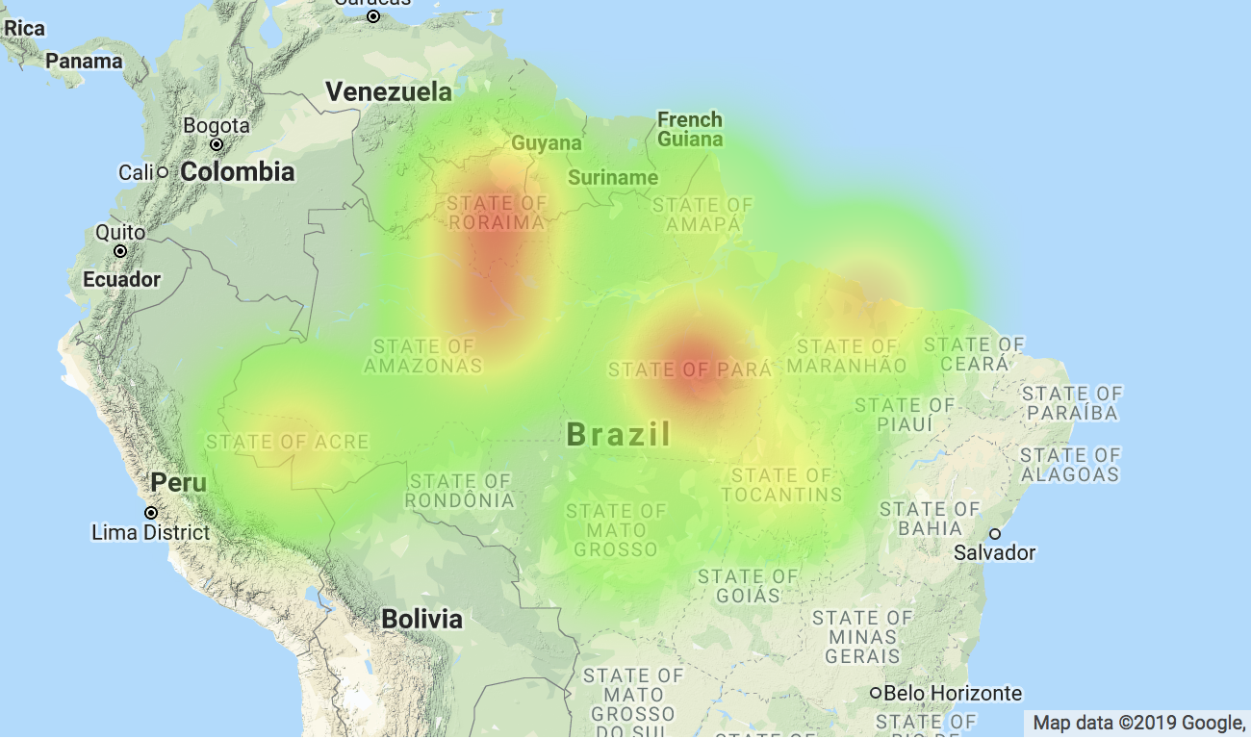
Heat Map: Legal Amazon Deforestation
Notes:
Stacy
Interior State of Amazonas followed by Para
Reminder of the footprint of an arid climate called Cerrado

Slide 21
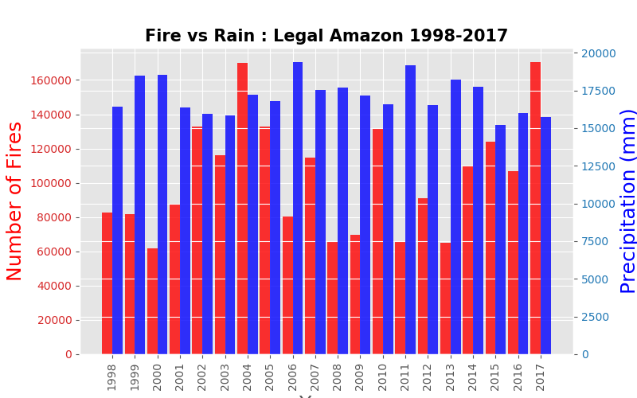
Notes:
You can see a correlation here which Michelle will dive into a little more later - 1999, 2000, 2006 and 2011 show that the years with the highest precipitation also had the lowest forest fires

Slide 22
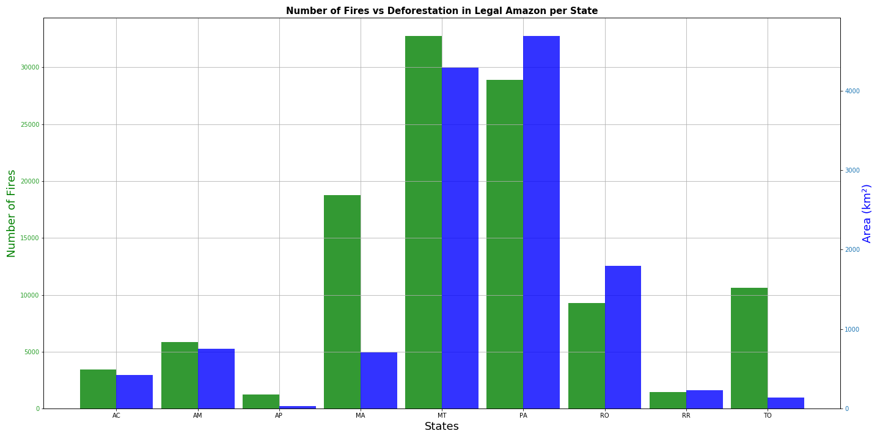
Fire x Deforestation in Legal Amazon per State
Notes:
Stacy

Slide 23
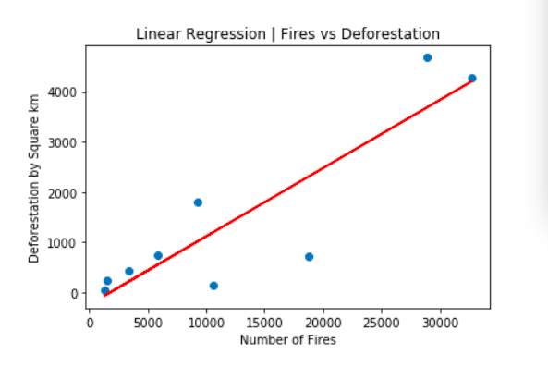
Correlation: Fire and Deforestation
Slope: 0.136
R-Squared: 0.873
Pearson’s Correlation Coefficient: 0.889
Notes:
Michelle
R-squared = PCC^2
PC = linear relationship between X & Y
R-squared = proportion of the variance in the dependent variable that is predictable from the independent variable

Slide 24
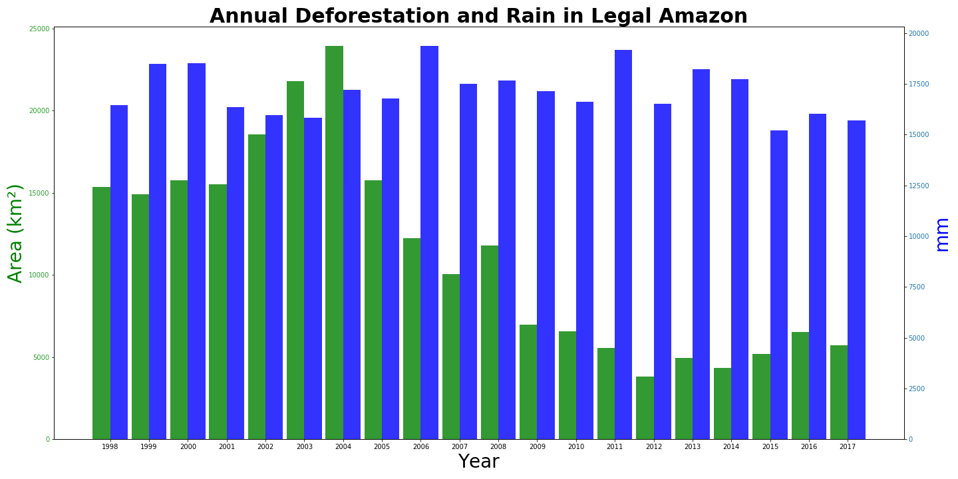
Notes:
Joao

Slide 25
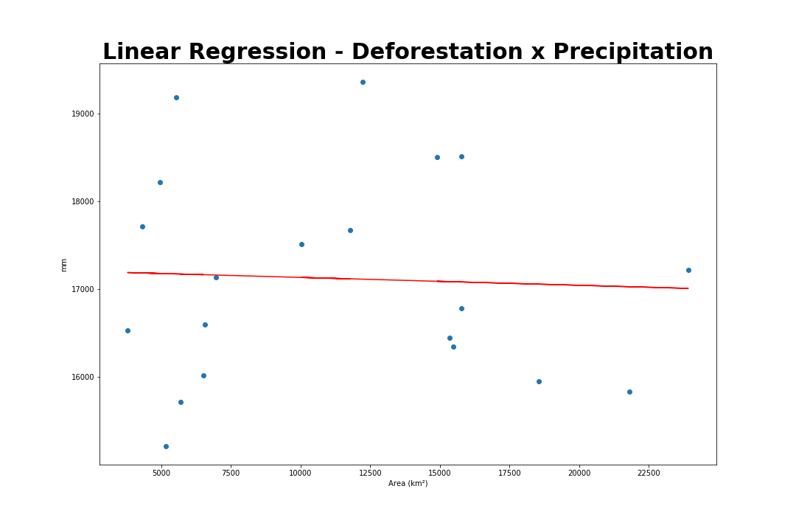
Correlation: Fire and Deforestation
R-squared : 0.772

Slide 26
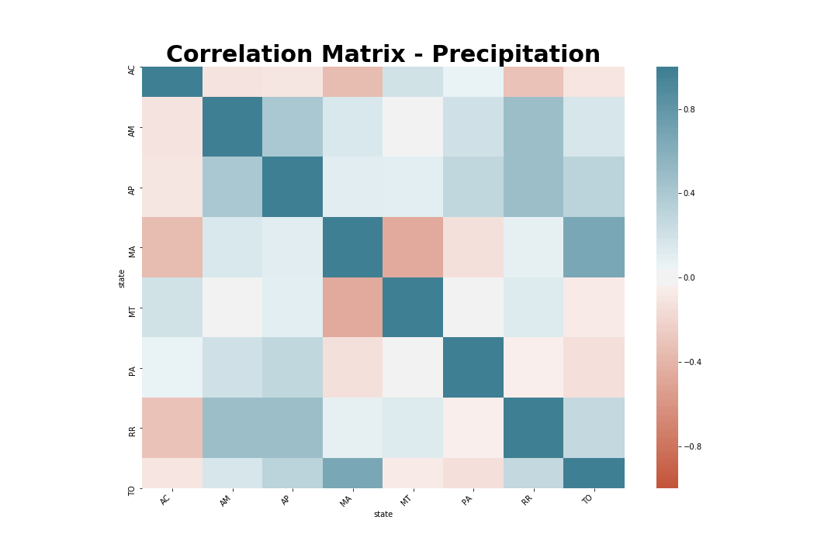
Notes:
Joao

Slide 27
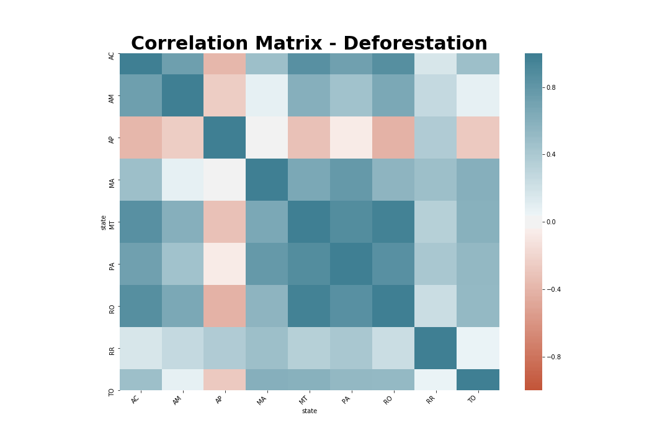

Slide 28
Data sources and APIs
Data Sources
TerraBrasilis - Deforestation data - http://terrabrasilis.dpi.inpe.br/
Kaggle - Precipitation - https://www.kaggle.com/fabiopotsch/precipitation-in-brazil
Kaggle - Forest Fires - https://www.kaggle.com/gustavomodelli/forest-fires-in-brazil
API’s
Google Geo-location APIs - https://cloud.google.com/maps-platform/
Notes:
Stacy

Slide 29
Credits
Shapes & Icons
Backgrounds
Images
Vectorial Shapes in this Template were created by Poweredtemplate.com and downloaded from FreePik.com
Icons in this Template are part of Google® Material Icons and FreePik.com
The backgrounds were created by Free Google Slides Templates. or using images from Pixabay.com
Photos in this template were downloaded from pixabay.com Attribution is located in each slide notes and the Credits slide.
Fonts
Trademarks
The fonts used in this template are taken from ufonts.com fonts.
( Rockwell)
You can download the fonts from the following url: http://ufonts.com/fonts/rockwell.html
Microsoft® and PowerPoint® are trademarks or registered trademarks of Microsoft Corporation.
© 2015 Google Inc, used with permission. Google and the Google logo are registered trademarks of Google Inc.
Google Drive® is a registered trademark of Google Inc.

Slide 30
Thanks!
Any questions?

